Slide 1
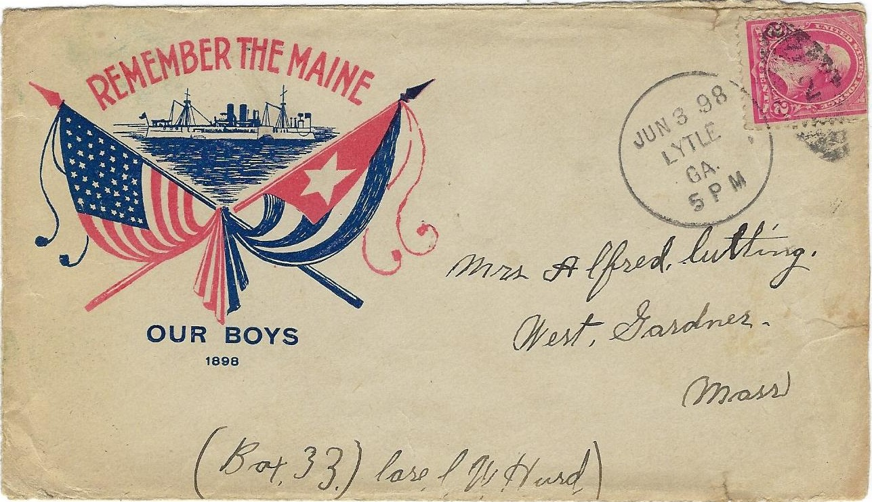
Patriotic Envelopes of Camp George H. Thomas Lytle, Georgia Spanish American War 1898
James C. Cate

Slide 2
Chattanooga – Chickamauga National Military Park 1890 Authorized by Congress 1895 Opened Camp George H. Thomas – Lytle, Georgia April 14, 1898 75,000 Troops Passed Through Spanish American War April 21, 1898 – August 13, 1898 115 Days 280,564 Troops – State National Guard Units

Slide 3
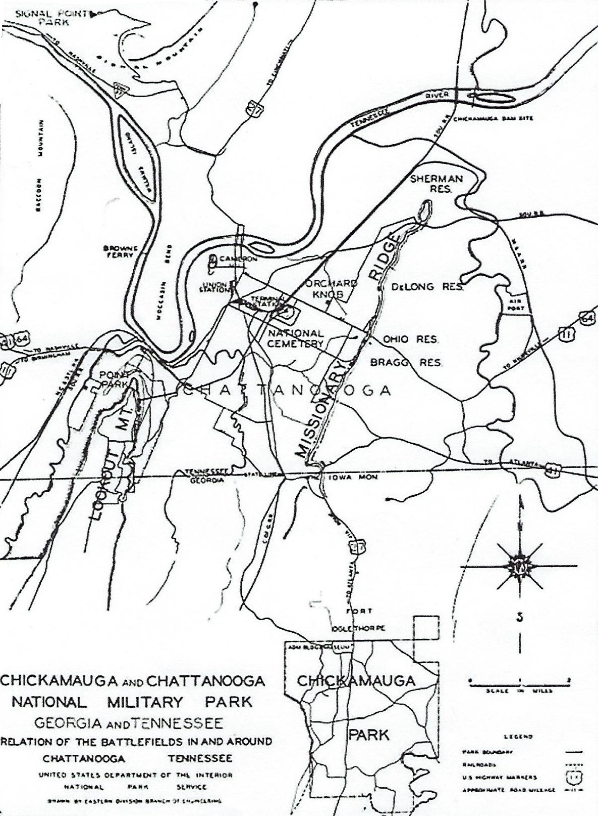
Chickamauga and Chattanooga National Military Park
Fort Oglethorpe
Camp George H. Thomas
Lytle, Georgia
Georgia – Tennessee
State Line

Slide 4
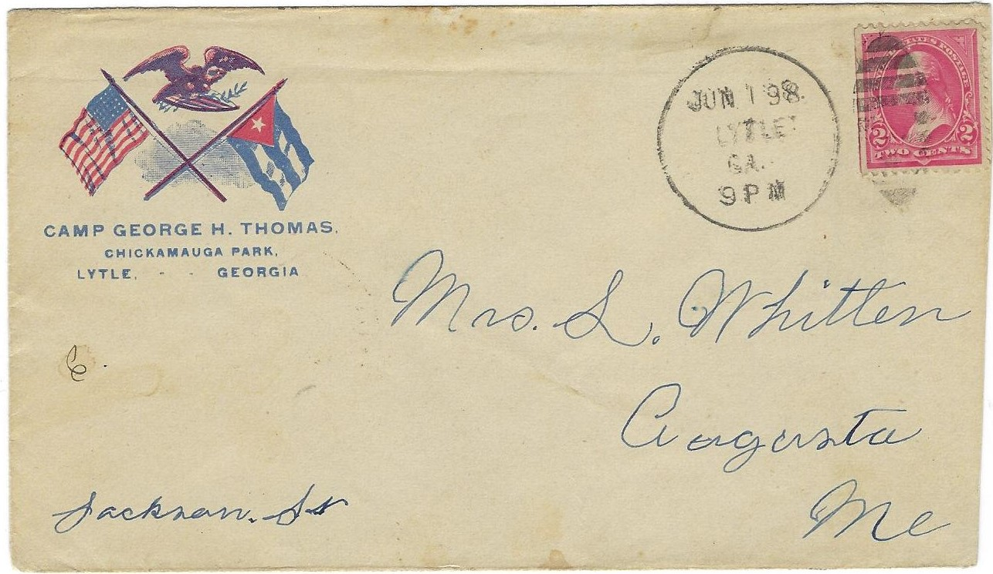
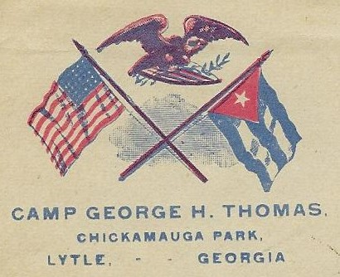
Early Spanish American War Patriotic Envelopes
U.S. and Cuban Flag with Eagle

Slide 5
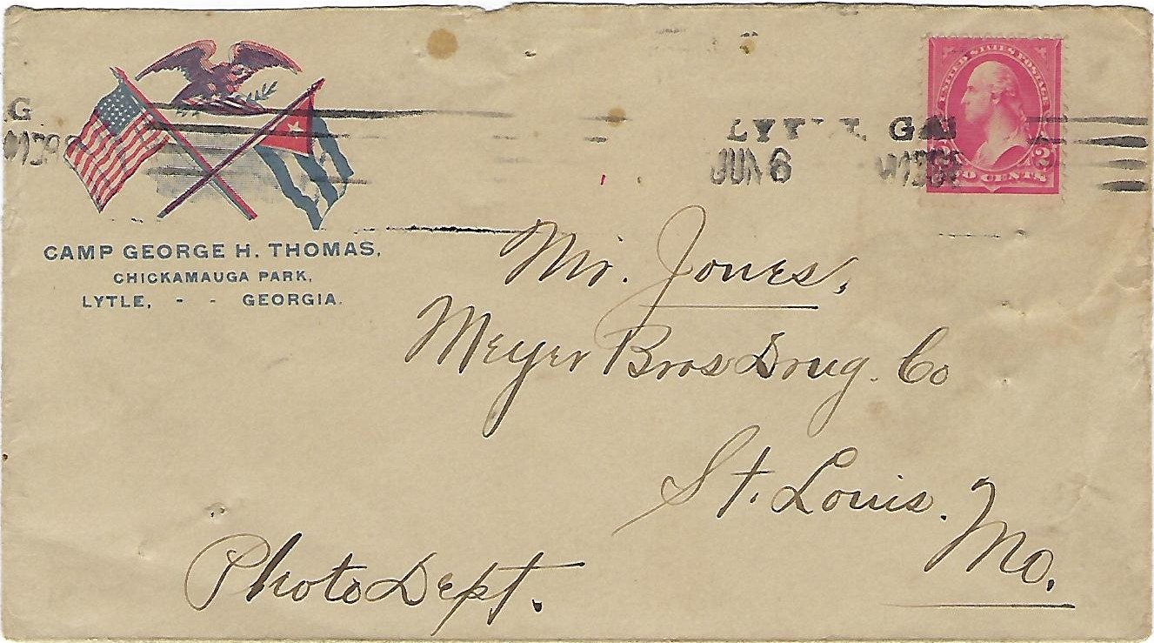
Early Patriotic Envelopes – Straight-line Postmark

Slide 6
Identity of Patriotic Envelope Producers
T. H. Payne Company – Chattanooga, TN
Heard Respess Company – Chattanooga, TN
Crandall-Bradt Printing Company – Chattanooga, TN
New South Engraving Company – Chattanooga, TN
Robert E. M. Suverkrop – Chattanooga, TN

Slide 7
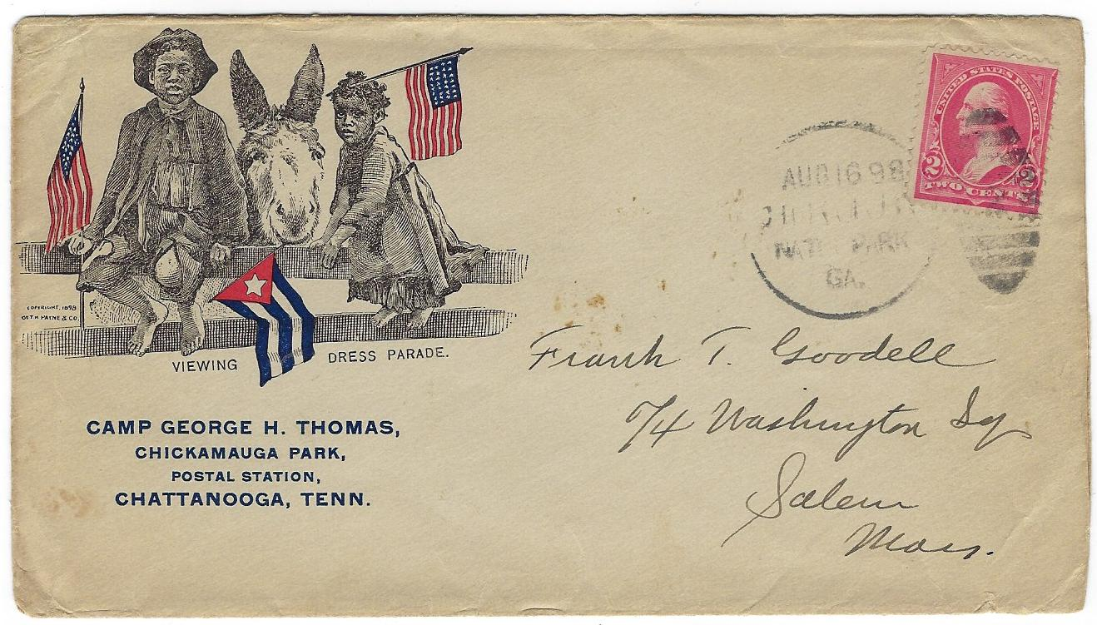
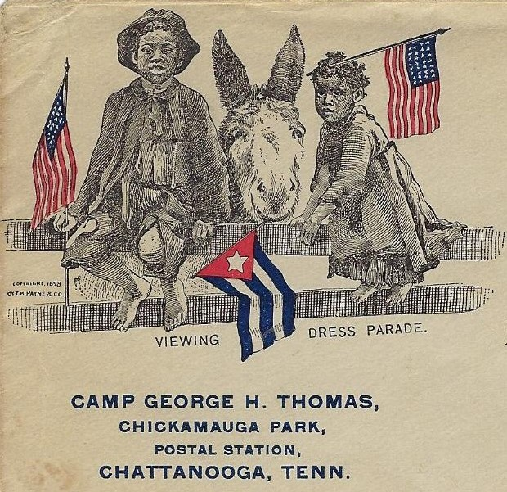
T. H. Payne & Company – Envelope Producer
Copyright 1898 – T. H. Payne & Company

Slide 8
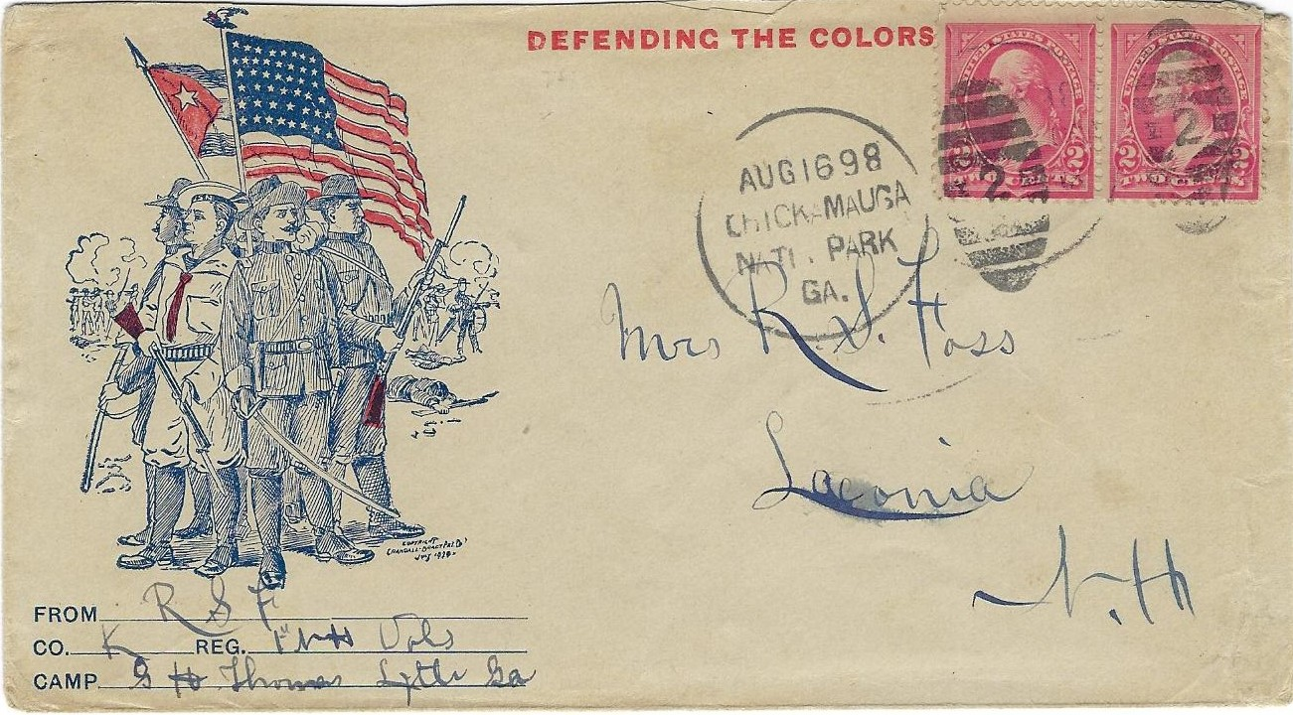
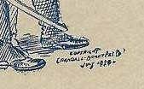
Crandall-Bradt Printing Co. – Envelope Producer
Copyright
Crandall-Bradt Printing Co.
July 1898

Slide 9
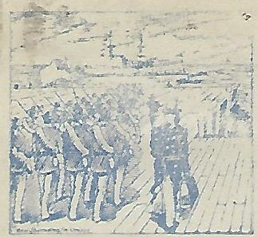
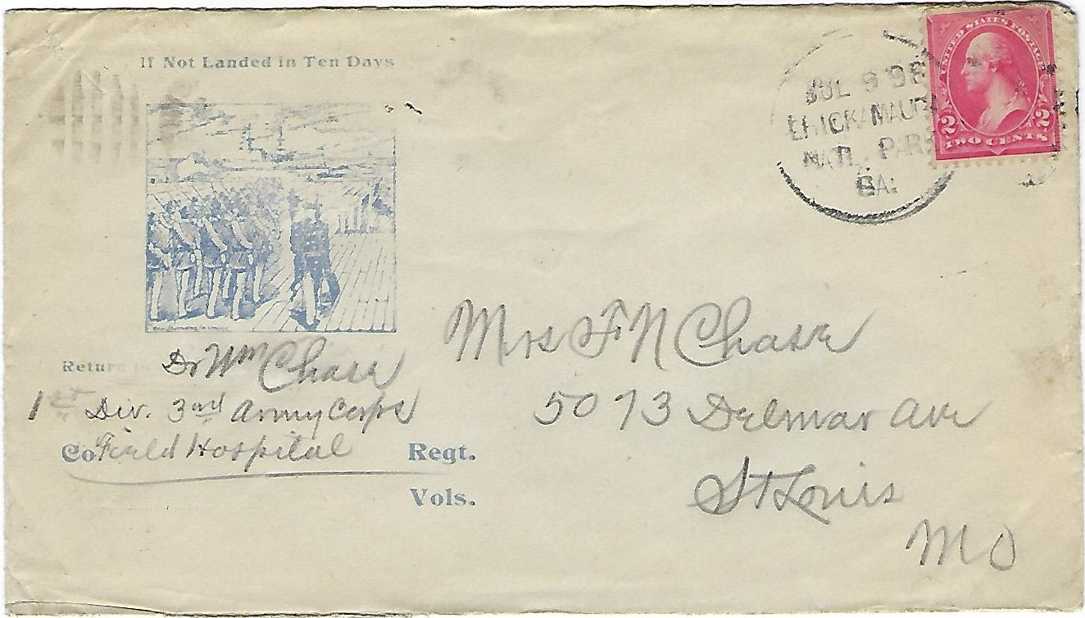
New South Engraving Company – Envelope Producer
New South Engraving Company

Slide 10
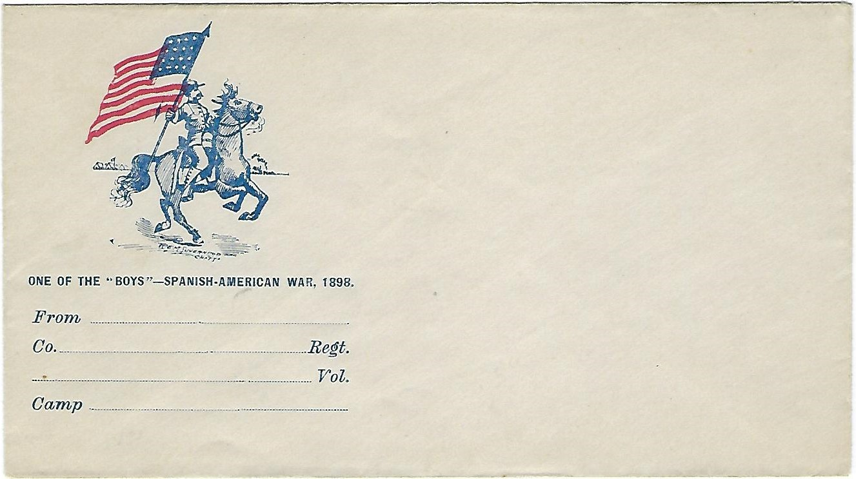
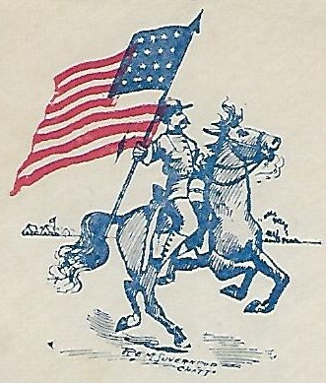
Robert E. M. Suverkrop – Envelope Producer
R E M Suverkrop – Chatt.

Slide 11
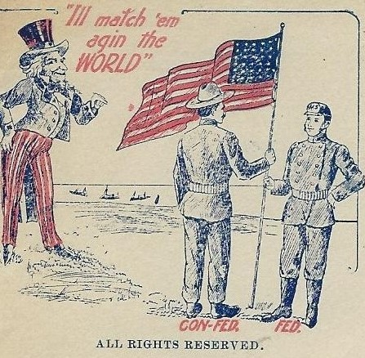
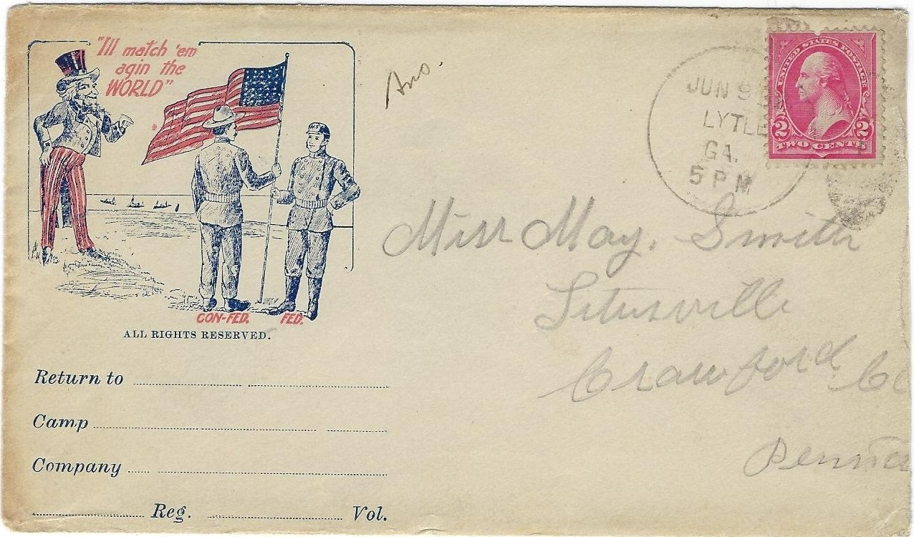
Unidentified Envelope Producer
Copyright

Slide 12
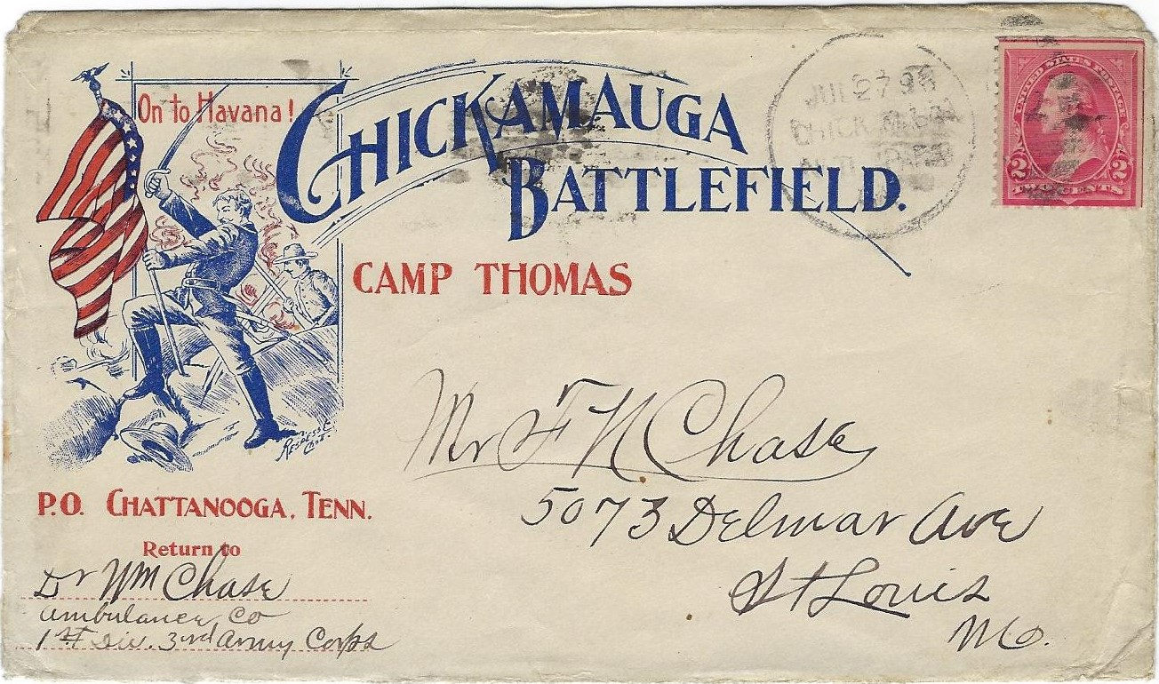
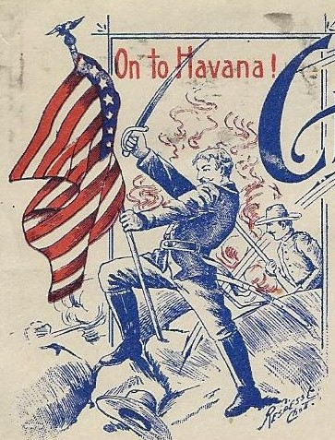
Heard Respess Company – Patriotic Envelopes
Respess Co. – Chatt.

Slide 13
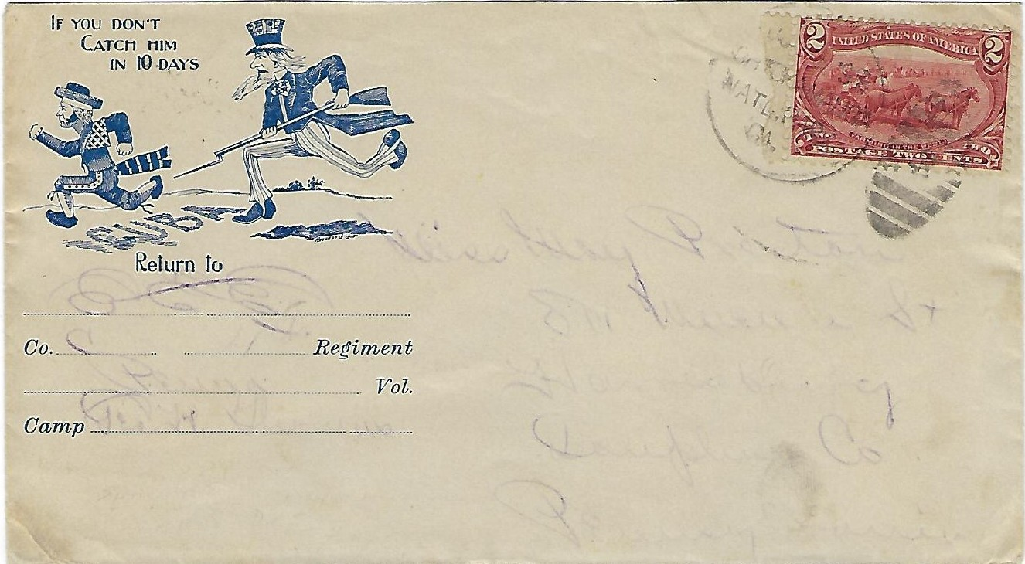
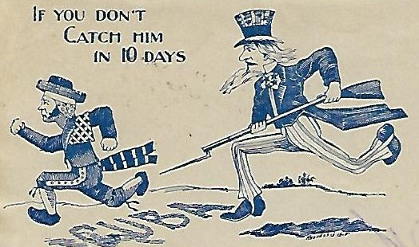
Heard Respess Company – Patriotic Envelopes
Respess Co. Chatt.

Slide 14
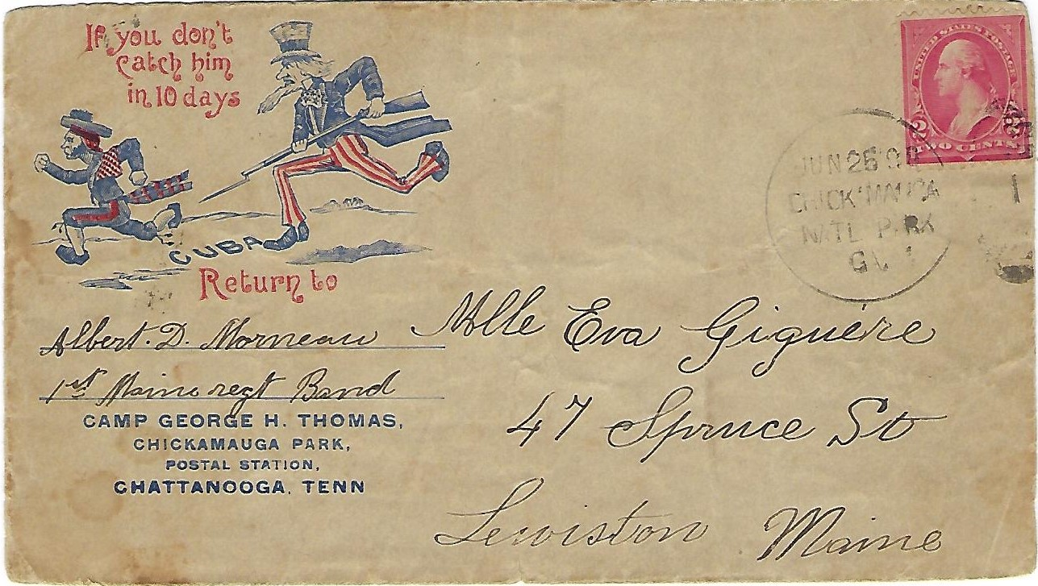
Respess Company – Patriotic Envelopes
Missing – Respess Co.
Present on Other Designs

Slide 15
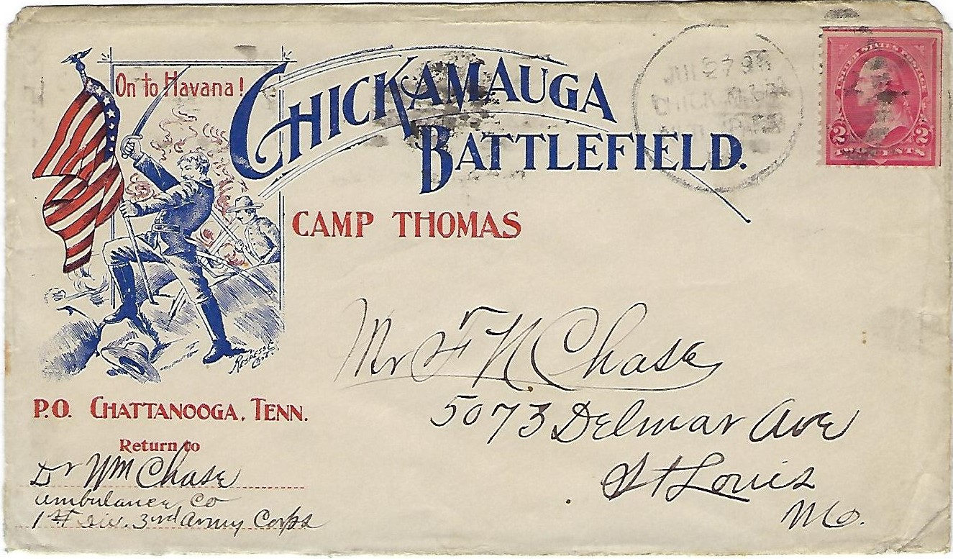
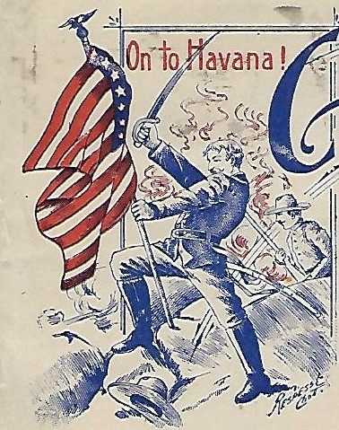
Respess Company – Patriotic Envelopes
Respess Co. – Chatt.

Slide 16
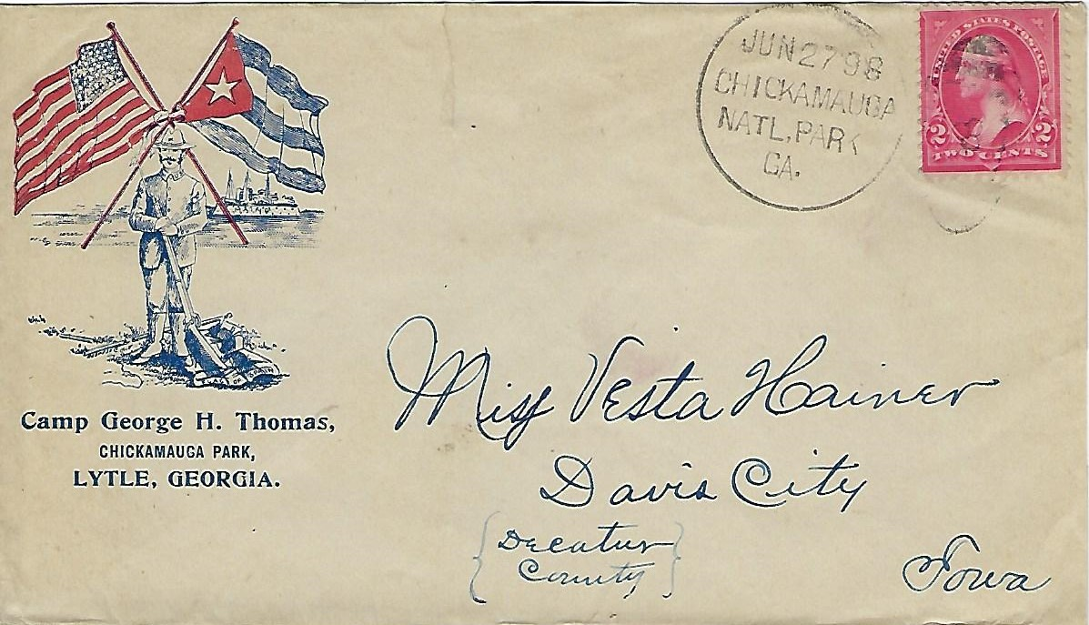
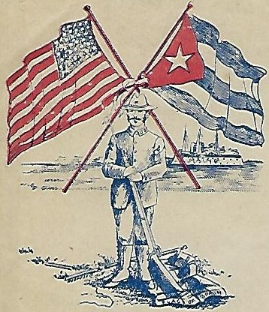
Respess Company – Patriotic Envelopes
Respess Co. - Chatt

Slide 17
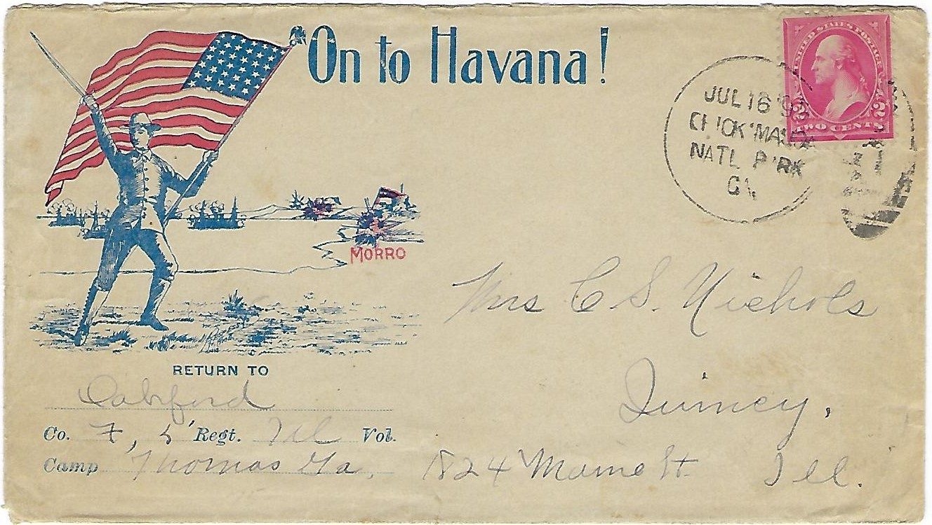
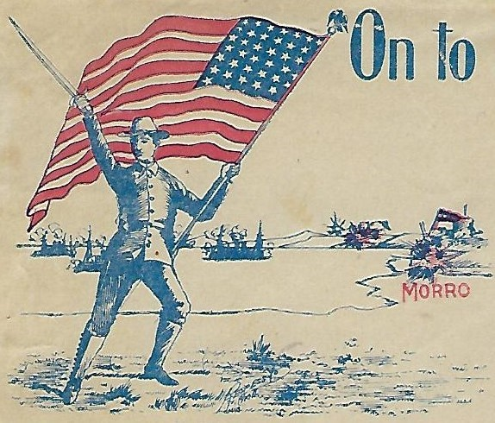
Respess Company – Patriotic Envelopes
Respess Co. - Chatt.

Slide 18
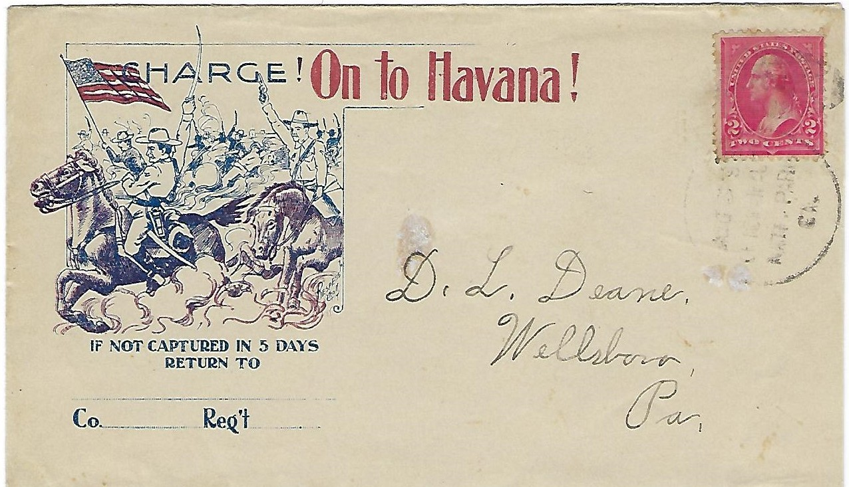
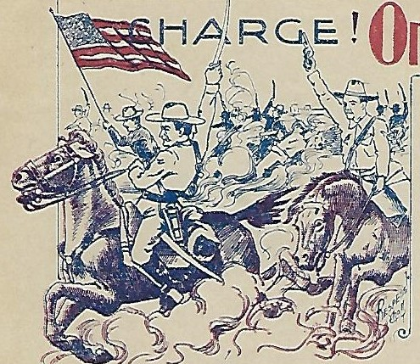
Respess Company – Patriotic Envelopes
Respess Co. – Chatt.

Slide 19
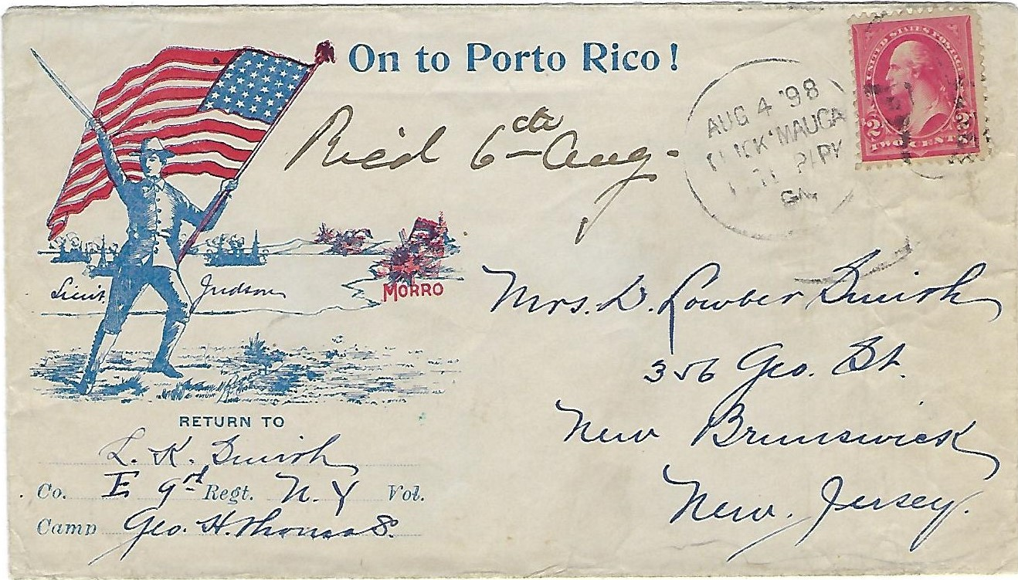
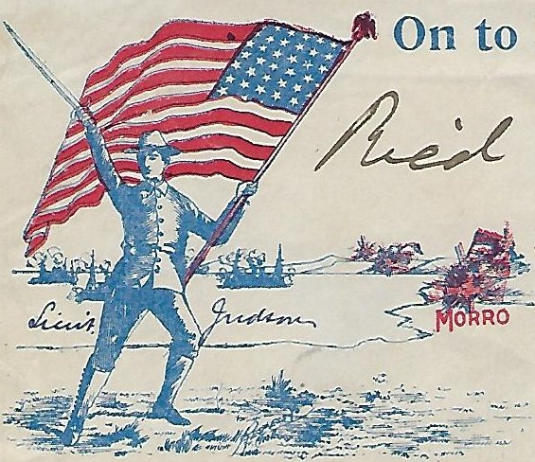
Respess Company – Patriotic Envelope
Similar Design As
“On to Havana”
Wording Different
Respess Co. – Chatt.

Slide 20
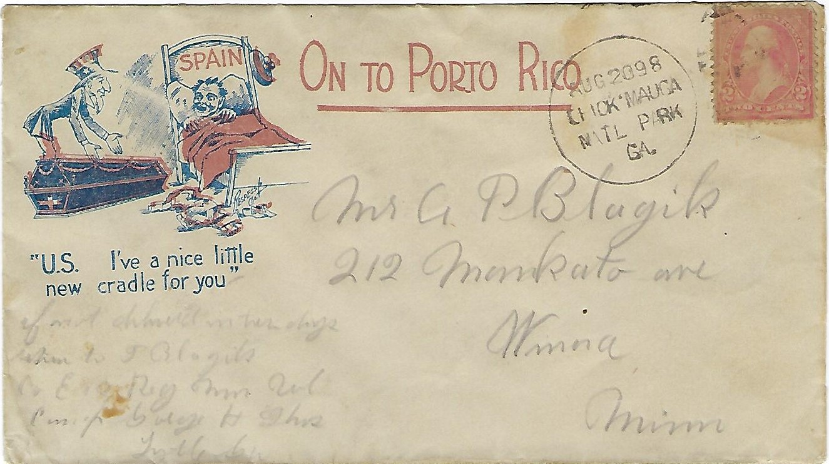
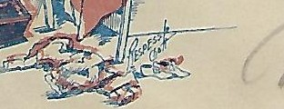
Respess Company – Patriotic Envelope
Rare Design
Late Use
Respess Co. – Chatt.

Slide 21
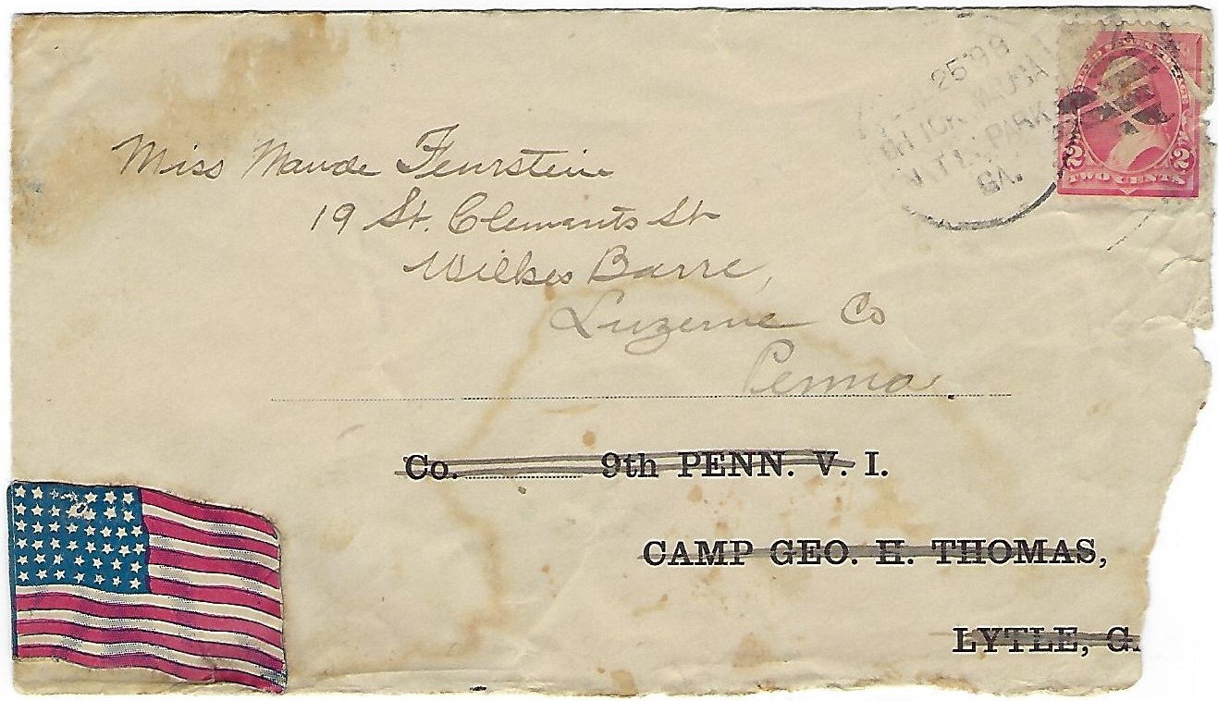
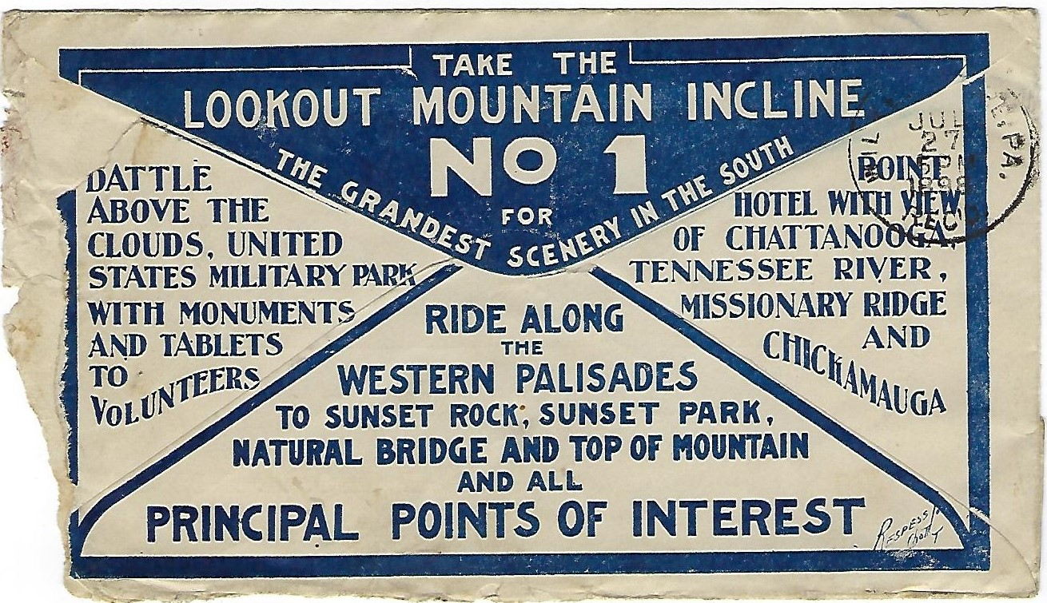
Respess Company – Back Side Design
Respess Co. – Chatt T

Slide 22
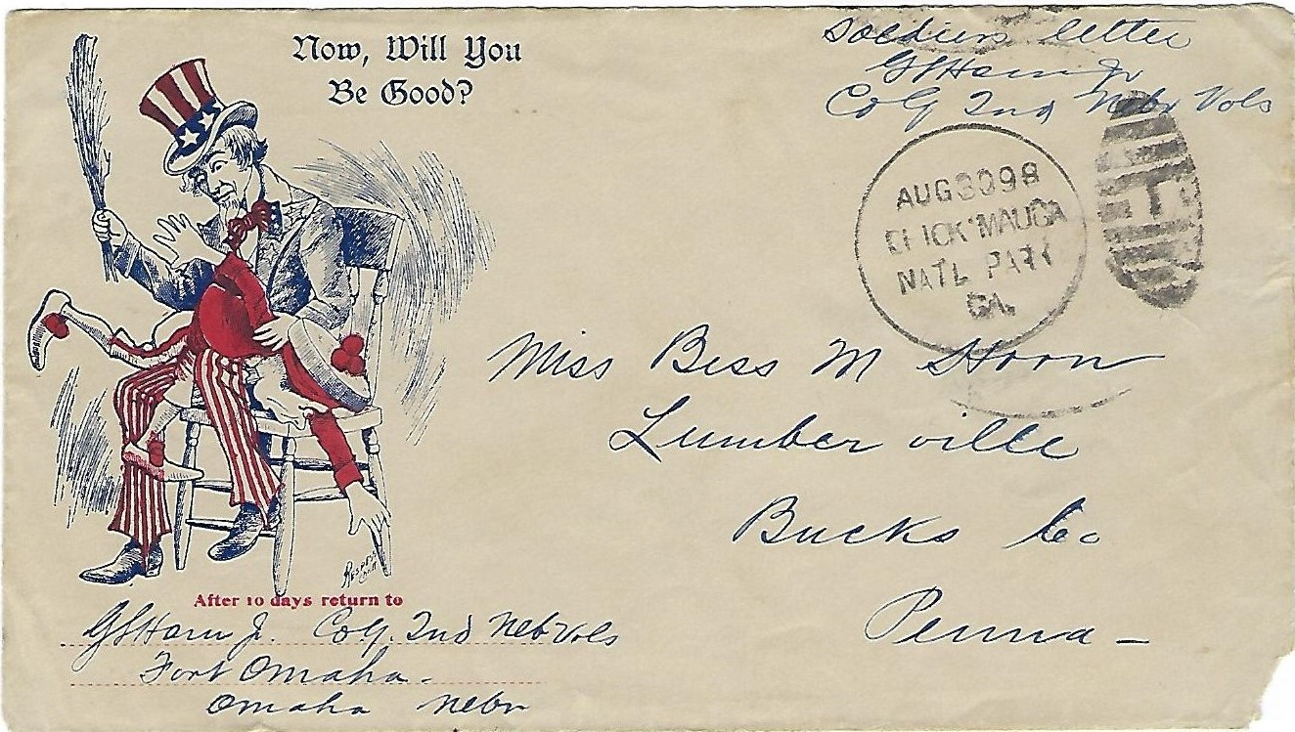
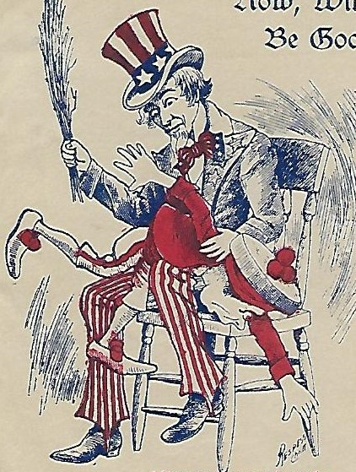
Respess Company – Patriotic Envelopes
Respess Co – Chatt.

Slide 23
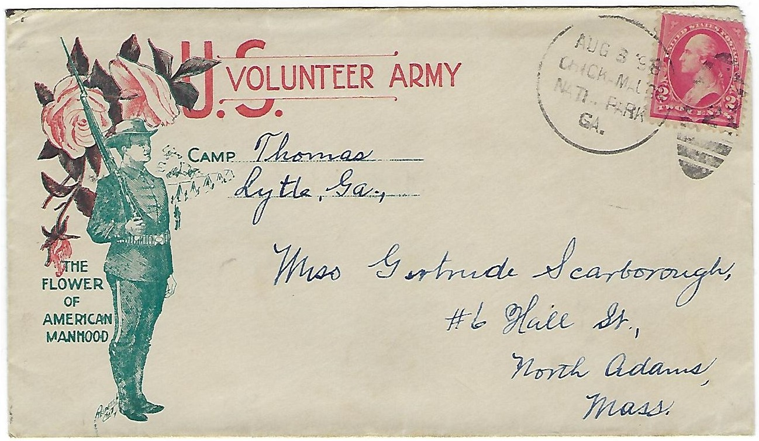
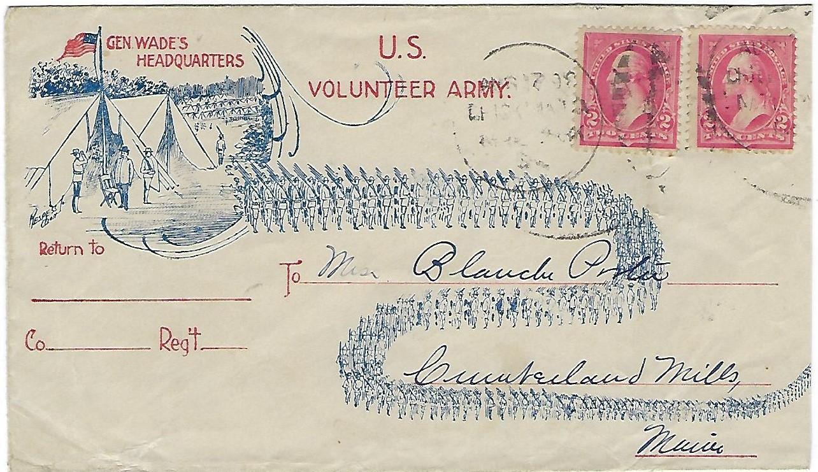
Respess Company – Patriotic Envelopes

Slide 24
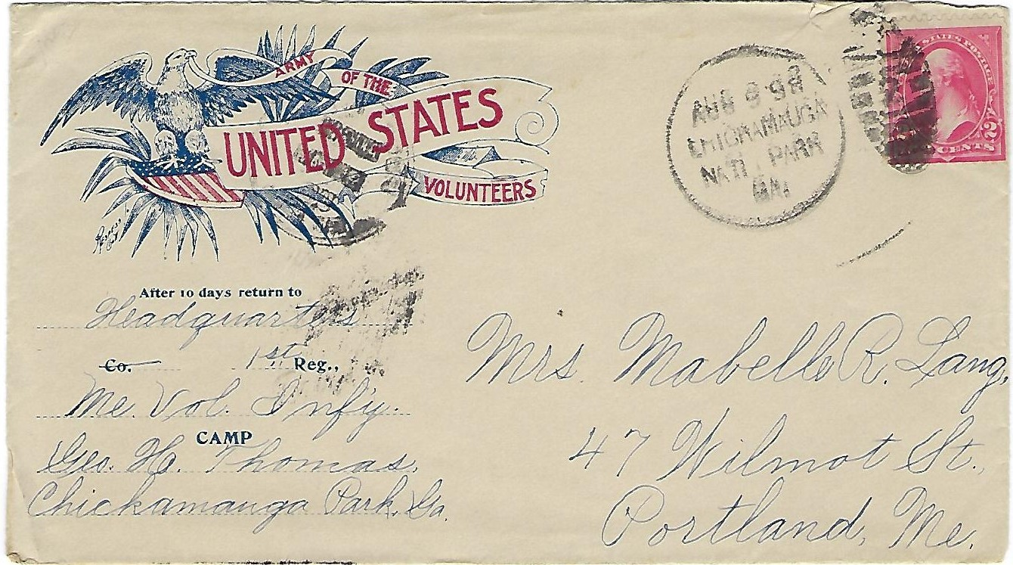
Respess Company – Patriotic Envelopes
Respess Co - Chatt

Slide 25
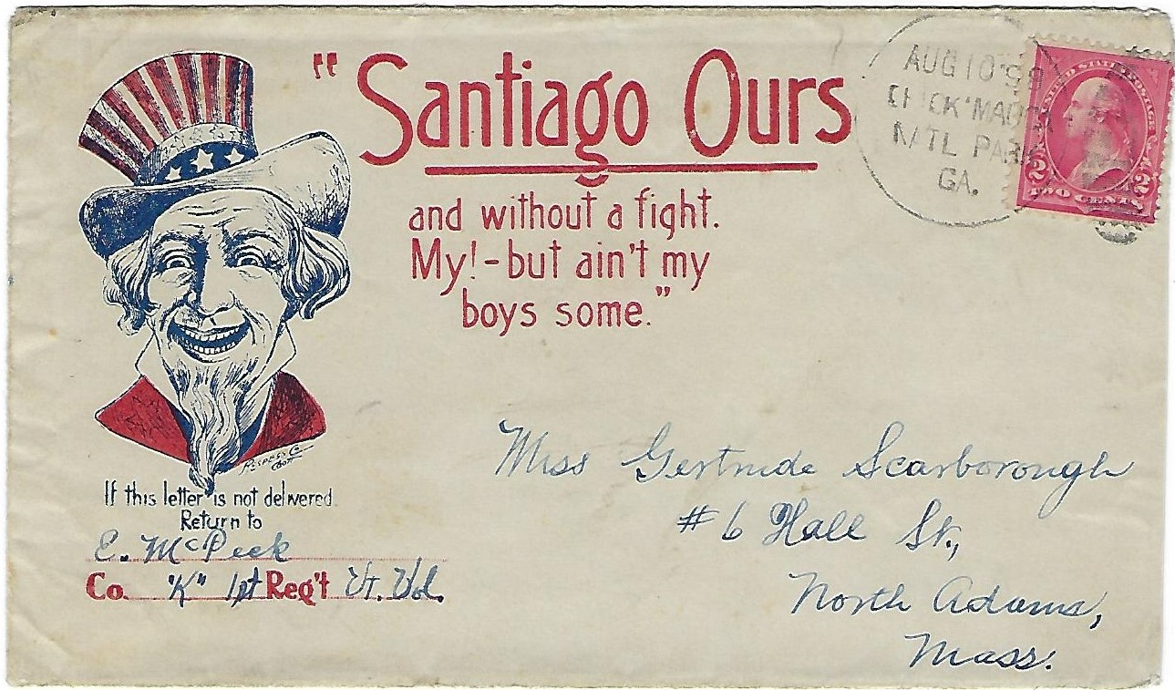
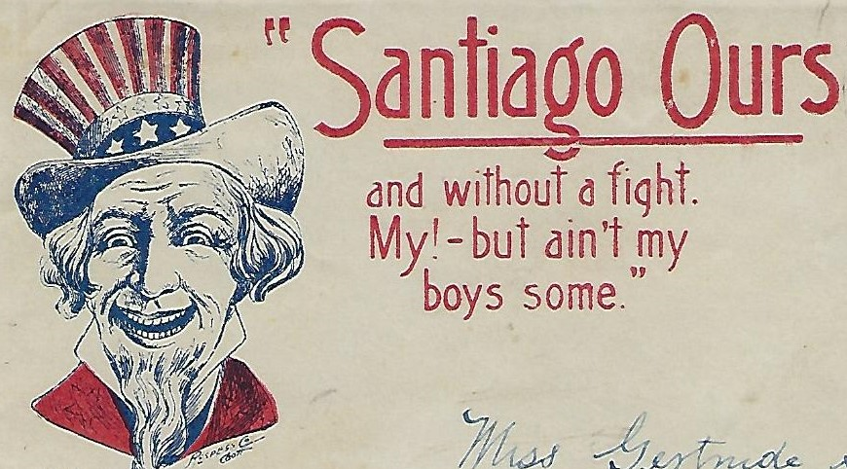
Respess Company – Patriotic Envelopes
Respess Co - Chatt

Slide 26
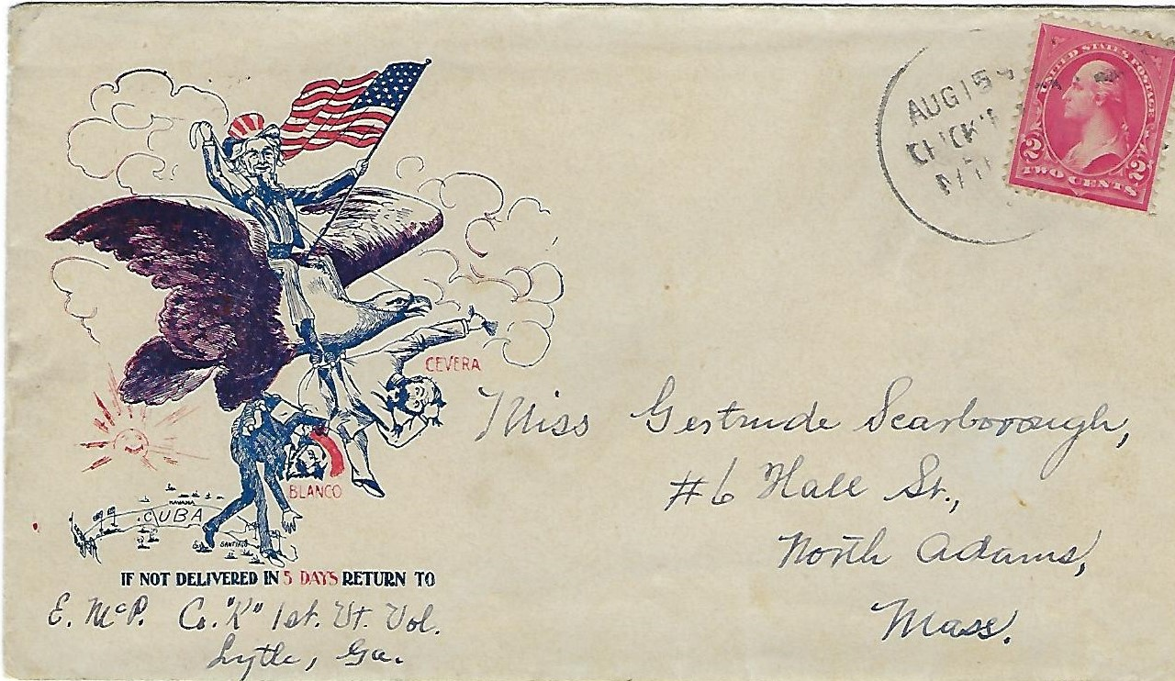
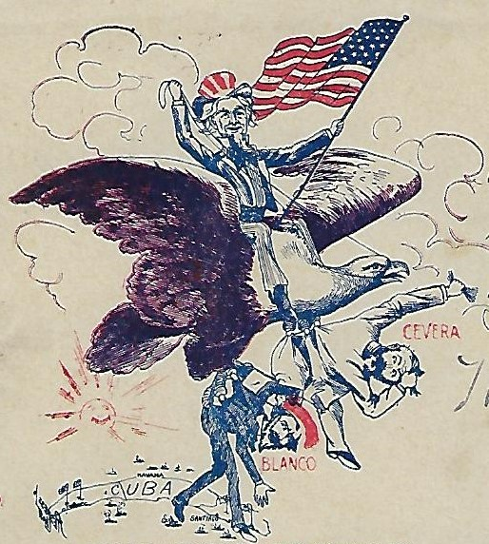
Respess Company – Patriotic Envelopes
Inverted - Respess Co - Chatt

Slide 27
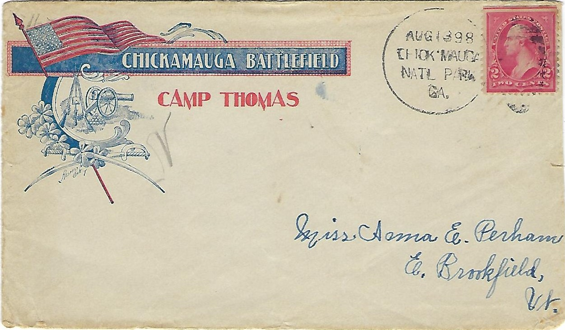
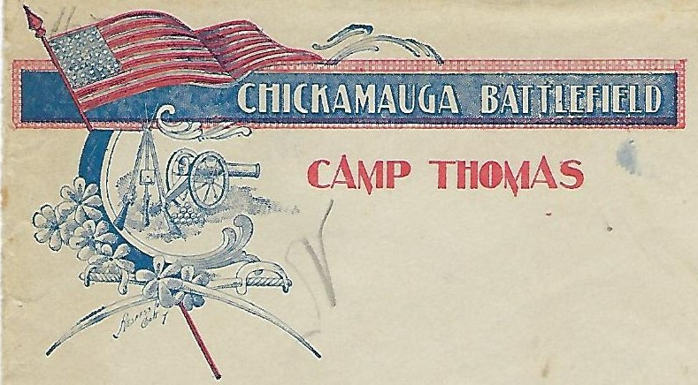
Respess Company – Patriotic Envelopes
Respess Co Chatt T

Slide 28
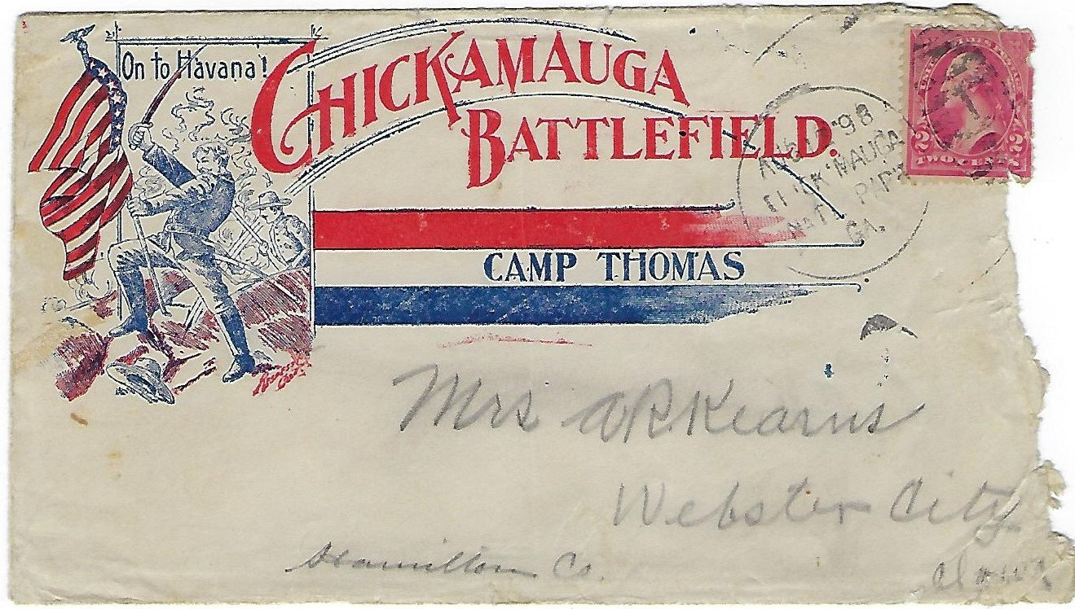
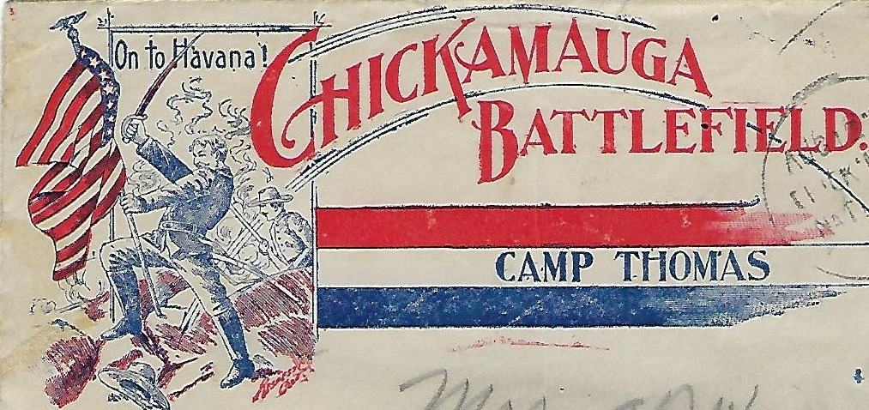
Respess Company – Patriotic Envelopes
Red
Respess Co – Chatt T

Slide 29
Respess Company – Patriotic Envelopes
Respess Co - Chatt

Slide 30
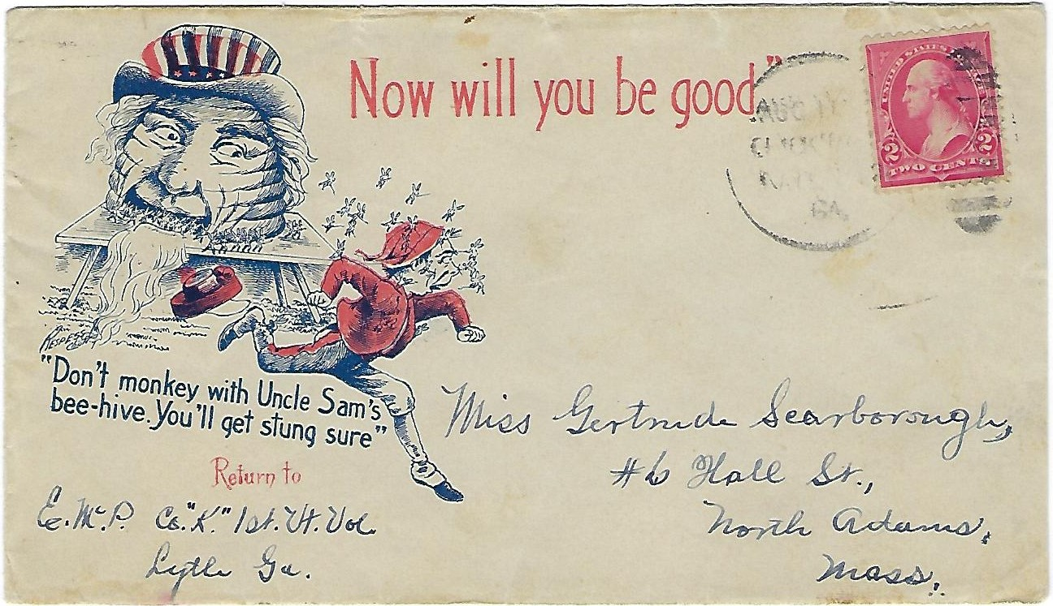
Respess Company – Patriotic Envelope
Respess Co – Chatt. T

Slide 31
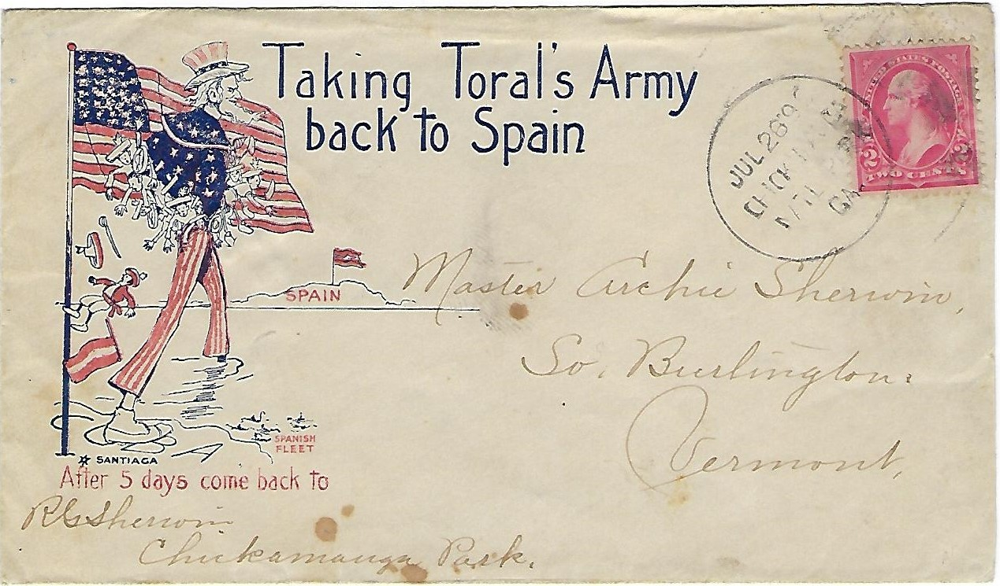
Patriotic Envelopes – Unidentified Producer

Slide 32
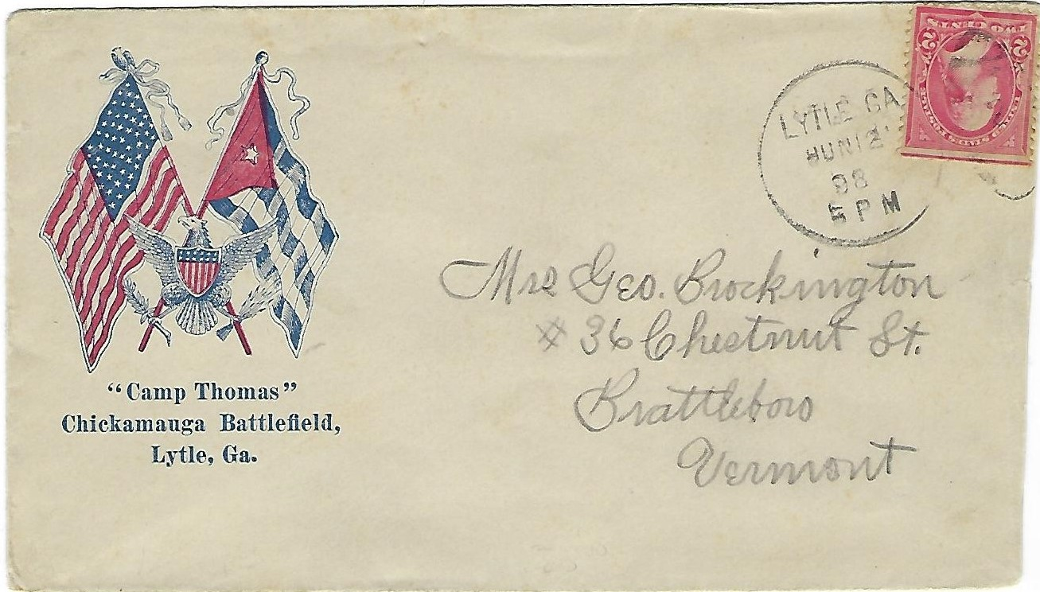
Patriotic Envelopes – Unidentified Producers

Slide 33
Patriotic Envelopes – Spelling Error - CHICKAMAUGA
CHICKMAGA - “U” MISSING
SEP 5 – (1898)

Slide 34
Patriotic Envelope – Postmark Letters Inversion
“.AG” - Inversion

Slide 35
Patriotic Envelopes – Unidentified Producer
Reported National Locations
Late Uses

